Slide 1
PRODUCTION THEORY
MGCR 293
Professor: Dr. K. Salmasi
Dr. Taweewan
Dr. Nizami
T.A.: Mike Brintnell
Presentation Credit: Brianna Mooney

Slide 2
Agenda
Chapter Review:
Production Function
Law of Diminishing Marginal Returns
Isocost/Isoquant Curves
Marginal Rate of Technical Substitution
Scale Economies
Chapter Questions

Slide 3
CHAPTER REVIEW

Slide 4
PRODUCTION THEORY
Production: the process by which inputs are combined, transformed and turned into outputs
Production theory deals with how managers decide what to produce, and how to produce it in the most efficient or least costly manner
Production theory involves the application of constrained optimization:
Minimize cost for a given a level of output
OR
Maximize output for a given production budget

Slide 5
THE PRODUCTION FUNCTION
A production function is a table, graph or equation showing the highest output that a firm can produce for every specified combination of inputs given a constant state of technology
(Flat World Education, Cooper, John)

Slide 6
PRODUCTION TABLE

Slide 7

AVERAGE PRODUCT
Average Product: total output divided by the quantity of an input used
${AP}_{x}=\frac{Q}{X}$ , where x is any input

Slide 8
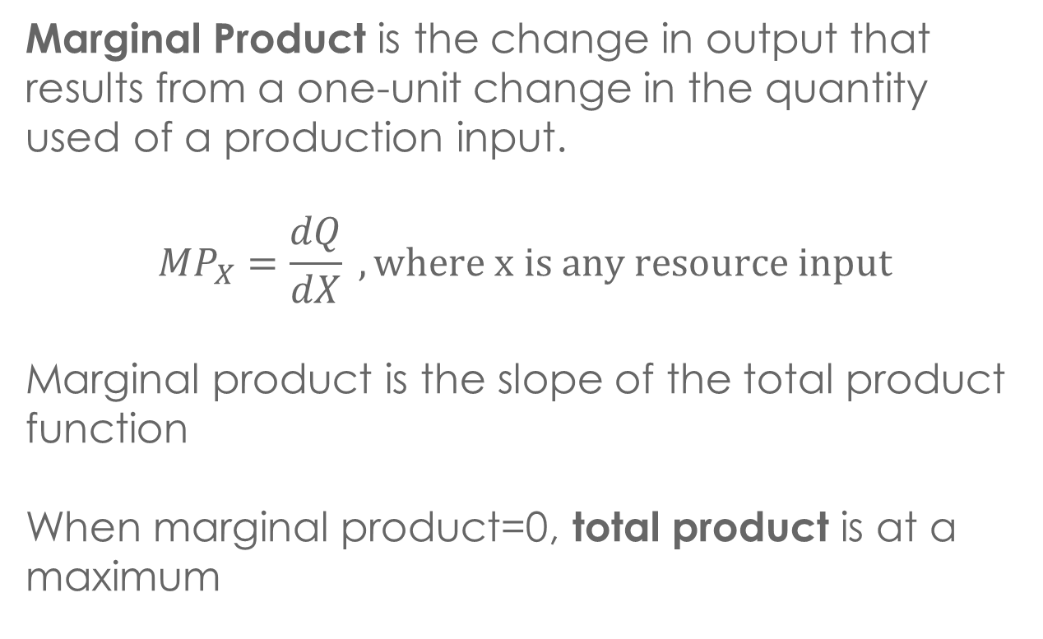
MARGINAL PRODUCT
Marginal Product is the change in output that results from a one-unit change in the quantity used of a production input.
$${MP}_{X}=\frac{dQ}{dX} , where x is any resource input$$
Marginal product is the slope of the total product function
When marginal product=0, total product is at a maximum

Slide 9
MARGINAL AND AVERAGE PRODUCT
When marginal product is greater than average product, average product is increasing.
When marginal product is less than average product, average product is decreasing
When marginal product = average product, average product is at a maximum
No Bull Economics, 2014

Slide 10
THE LAW OF DIMINISHING RETURNS
If equal increments of an input are added to a production process, and the quantities of other inputs are held constant, the marginal product of the input will eventually diminish
This is an empirical generalization, it assumes that technology remains fixed and the quantity of other inputs is fixed
https://www.youtube.com/watch?v=xLSRMt-wWAM

Slide 11
OPTIMIZATION OF INPUTS
Must understand the marginal revenue product of the variable input and the marginal expenditure of the variable input:
The marginal revenue product (MRP) of variable input X is the change in total revenue caused by a one-unit change in the amount of X used
Marginal expenditure of variable input X (ME_{x}) is the change in a firm’s total cost caused by a one-unit change in amount of X used

Slide 12
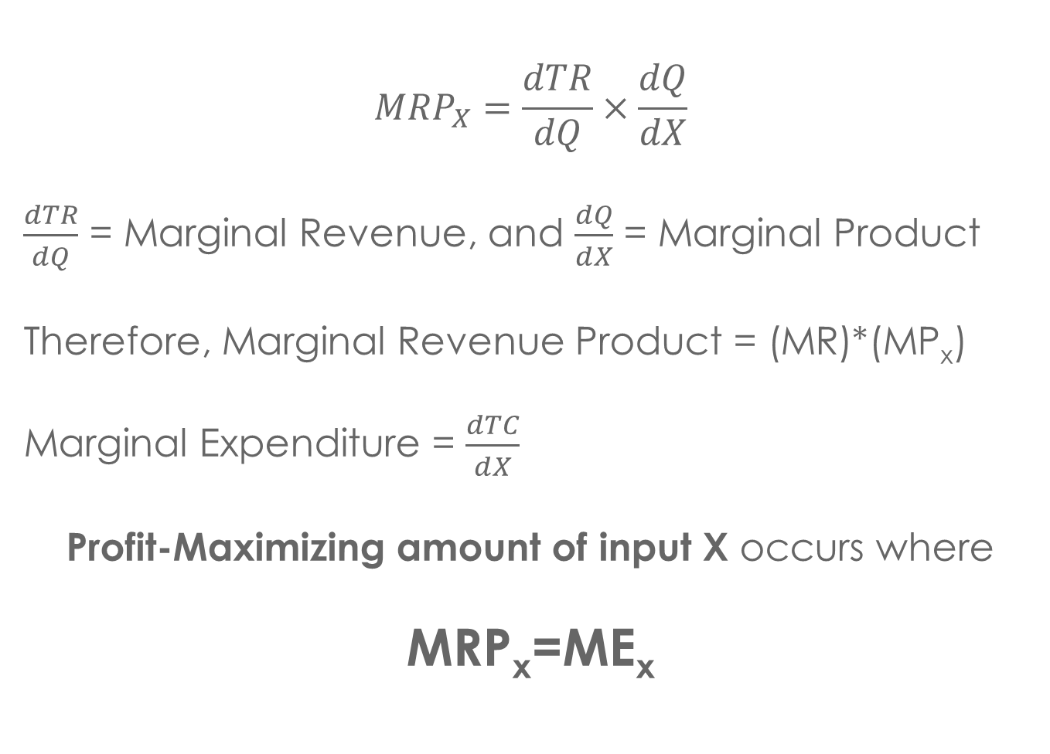
$${MRP}_{X}=\frac{dTR}{dQ}×\frac{dQ}{dX}$$
$\frac{dTR}{dQ}$ = Marginal Revenue, and $\frac{dQ}{dX}$ = Marginal Product
Therefore, Marginal Revenue Product = (MR)*(MP_{x})
Marginal Expenditure = $\frac{dTC}{dX}$
Profit-Maximizing amount of input X occurs where
MRP_{x}=ME_{x}

Slide 13
ISOQUANT AND ISOCOST
Isoquant: a curve showing all possible combinations of inputs that yield the same output. In other words, output is constant along each isoquant curve.
Shows producers how to respond efficiently to changes in the markets for inputs

Slide 14
ECONOMIC ZONE OF PRODUCTION
The region between the ridge lines, which connects all the points on the isoquants where marginal product of the two inputs are zero.
Outside of these ridge lines, the marginal product of one input is negative, meaning that each additional unit of that input used is adding decreasing amounts of output. Therefore, managers will not choose to use combinations of inputs outside of the ridgelines

Slide 15
SUBSTITUTING INPUTS
There are some degrees of substitutability between inputs:
Perfect substitution (substitute inputs in fixed proportions)
Perfect complementarity (fixed proportions of two inputs and no ability for substitution)
Imperfect substitution (varying degrees of substitutability)

Slide 16
ISOQUANT CURVES

Slide 17
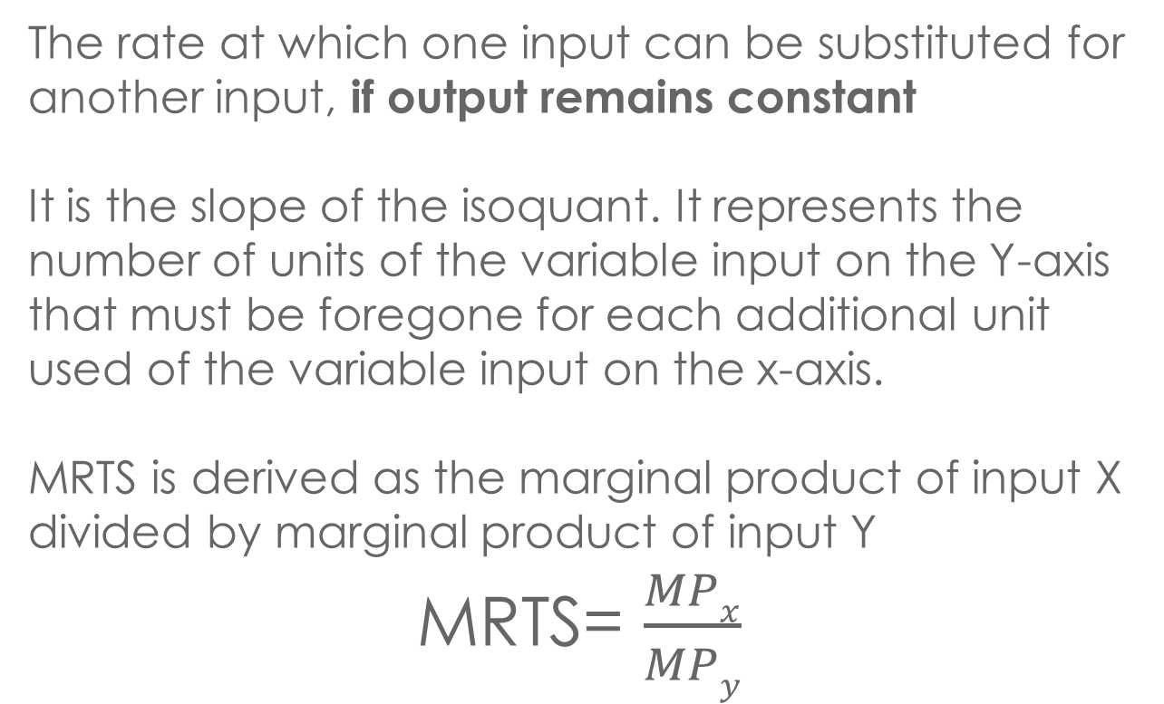
MARGINAL RATE OF TECHNICIAL SUBSTITUTION
The rate at which one input can be substituted for another input, if output remains constant
It is the slope of the isoquant. It represents the number of units of the variable input on the Y-axis that must be foregone for each additional unit used of the variable input on the x-axis.
MRTS is derived as the marginal product of input X divided by marginal product of input Y
MRTS= $\frac{MPx}{MPy}$

Slide 18
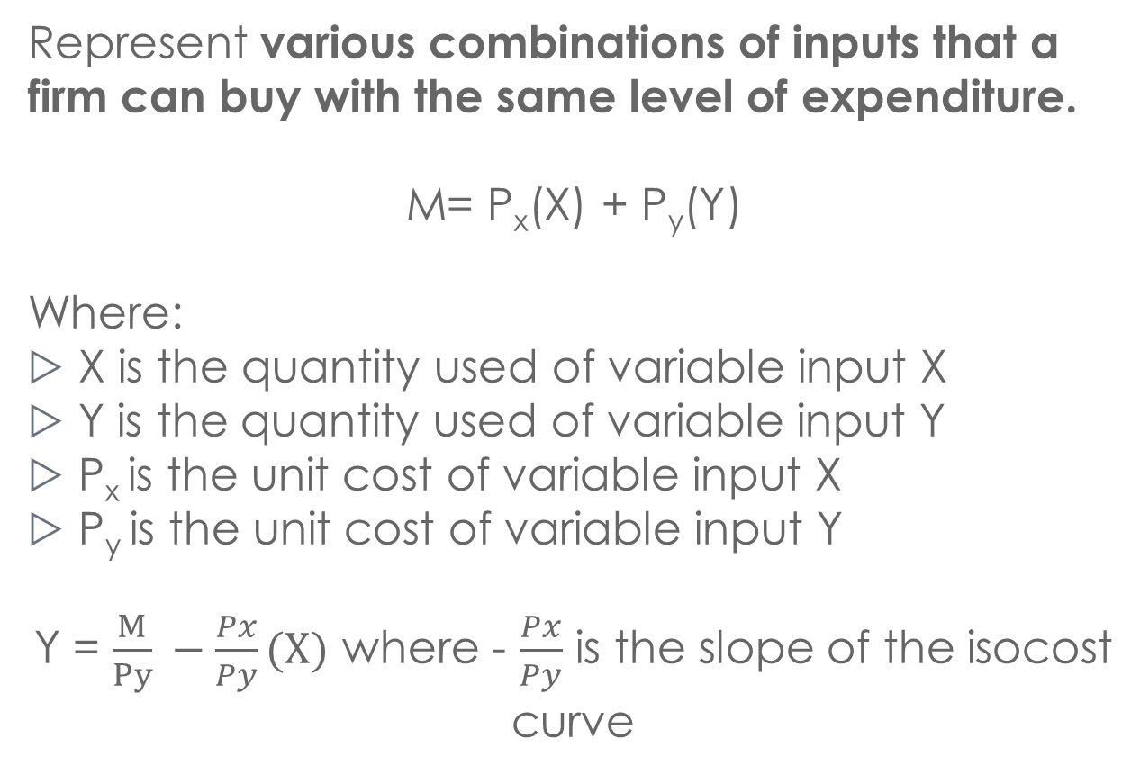
ISOCOST CURVES
Represent various combinations of inputs that a firm can buy with the same level of expenditure.
M= P_{x}(X) + P_{y}(Y)
Where:
X is the quantity used of variable input X
Y is the quantity used of variable input Y
P_{x} is the unit cost of variable input X
P_{y} is the unit cost of variable input Y
Y = $\frac{M}{Py} −\frac{Px}{Py}(X)$ where - $\frac{Px}{Py}$ is the slope of the isocost curve

Slide 19
ISOCOST CURVE

Slide 20
MAXIMIZING OUTPUT GIVEN COST
To find the combination of inputs which maximize the output for a given expenditure, we should pick the point on the isocost curve that is on the highest isoquant (where the isocost curve is tangent to the isoquant)
Since the slope of the isocost curve is -(Px)/(Py) and the slope of the isoquant is -(MPx)/(MPy), it follows that:
MP_{X}/MP_{Y} = P_{X}/P_{Y}
MP_{X}/P_{X} = MP_{Y}/P_{Y}
Capital
R
Labour

Slide 21
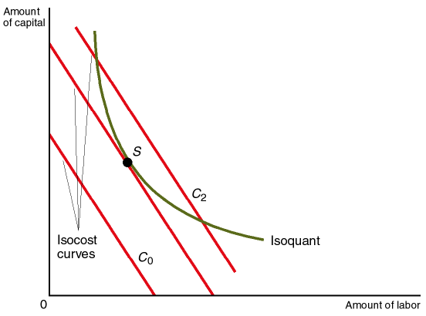
MINIMIZING COST GIVEN OUTPUT
To find the combination of inputs which minimize the cost to produce a given output, we should pick the point on the lowest isocost curve that is tangent to isoquant representing the given output (where the isocost curve is tangent to the isoquant)
Since the slope of the isocost curve is -(Px)/(Py) and the slope of the isoquant is -(MPx)/(MPy), it follows that:
MP_{X}/MP_{Y} = P_{X}/P_{Y}
MP_{X}/P_{X} = MP_{Y}/P_{Y}

Slide 22
RETURNS TO SCALE
How output responds to changes in the scale of the firm in the long term
Increasing returns to scale means that output increases by a larger proportion than the increase in all inputs used
Decreasing returns to scale means that output increases by a smaller proportion than the increase in all inputs used
Constant returns to scale means that output increases by the same proportion as the increase in all inputs used

Slide 24
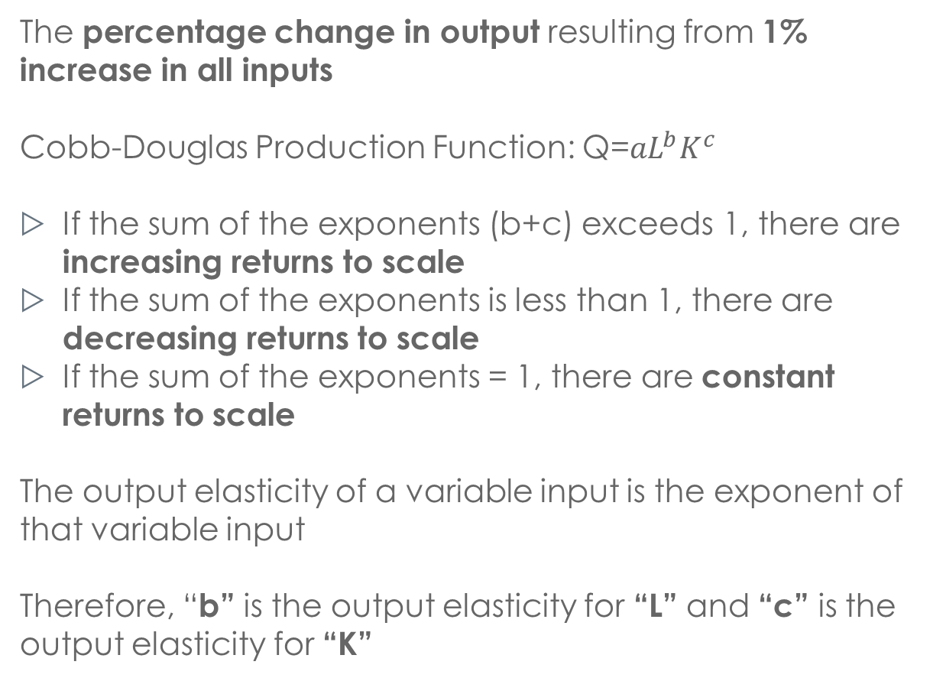
OUTPUT ELASTICITY
The percentage change in output resulting from 1% increase in all inputs
Cobb-Douglas Production Function: Q=${aL}^{b}K^{c}$
If the sum of the exponents (b+c) exceeds 1, there are increasing returns to scale
If the sum of the exponents is less than 1, there are decreasing returns to scale
If the sum of the exponents = 1, there are constant returns to scale
The output elasticity of a variable input is the exponent of that variable input
Therefore, “b” is the output elasticity for “L” and “c” is the output elasticity for “K”

Slide 25
CHAPTER QUESTIONS

Slide 26
QUESTION 1
In the Elwyn Company, the relationship between output (Q) and the number of hours of skilled labour (S) and the unskilled labour (U) is
Q=300S+200U – 0.2S² – 0.3U²
The hourly wage of skilled labour is $10, and the hourly wage of unskilled labour is $5. The firm can hire as much labour as it wants at these wage rates.
a) Elwyn’s chief engineer recommends that the firm hire 400 hours of skilled and 100 hours of unskilled labour. Evaluate the recommendation.

Slide 27
SOLUTION 1
We want to see if 400h of skilled (S) and 100h of unskilled (U) labour satisfy:
We take the partial derivatives of the production function with respect to both skilled and unskilled labour:

Slide 28
Next, we substitute the values for marginal product and the unit cost of each type of labour into our profit-maximizing formula:
Recall that skilled labour cost $10 and unskilled labour cost $5
Therefore at S=400 and U=100 this is not an optimal combination of inputs because the equation does not hold

Slide 29
b) If the Elwyn Company decides to spend a total of $5,000 on skilled and unskilled labour, how many hours of each type of labour should it hire?
Budget Constraint:
$5,000 = 10S + 5U
Recall from a) that:
Therefore if we re-write in terms of S:
S = -250 + 3U (rearranged)
Substituting into our budget constraint: $5,000 = 10S + 5U
$5,000= 10(-250+3U)+5U
Solve for U and then find S:
$5,000 = -2500 + 30U + 5U
7500 = 35U
U=214.3, S=392.9

Slide 30
QUESTION 1
c) If the price of a unit of output is $10 , how many hours of unskilled labour should the company hire?
Marginal revenue for 1 unit of output is $10, Marginal product of unskilled labour is 200 -0.6U, marginal expenditure for 1 unit of labour is $5
Therefore MRP_{u}=ME_{u}:
10(200-0.6U)=5
U=332.5

Slide 31
QUESTION 2
A consulting firm specializing in agriculture determines that the following combinations of hay and grain consumption per lamb will result in a 25-pound gain for a lamb:
POUNDS OF HAY | POUNDS OF GRAIN
40 | 130.9
50 | 125.1
60 | 120.1
70 | 115.7
80 | 111.8
90 | 108.3
110 | 102.3
130 | 97.4
150 | 93.8

Slide 32
QUESTION 2
a) The firm’s president wants to estimate the marginal product of a pound of grain in producing lamb. Can he do so on the basis of these data?

Slide 33
SOLUTION 2
No, because we are not given the amount of grain or hay that increases the lamb’s weight by itself, but the effect of a combination of the two variables.

Slide 34
QUESTION 2
b) The firm’s president is convinced that constant returns to scale prevail in lamb production. If this is true and hay and grain consumption per lamb are the only inputs, how much gain accrues if the hay consumption per lamb is 100 pounds and the grain consumption is 250.2 pounds?

Slide 35
SOLUTION 2
Constant returns to scale implies that output (ie: weight gain) increases by the same proportion that all inputs are increased by.
From table: 50 hay and 125.1 grain cause lamb’s weight to increase by 25 pounds
→But we want to know what happens when 100 hay and 250.2 grain are consumed… so double both
Therefore, 100 HAY and 250.2 GRAIN cause lamb’s weight to increase by 50 pounds

Slide 36
QUESTION 2
c) What is the marginal rate of technical substitution of hay for grain when between 40 and 50 pounds of hay are consumed per lamb?

Slide 37
SOLUTION 2
Want to find the slope of the isoquant curve at this point:
MRTS= –(125.1 – 130.9)/(50-40)=0.58

Slide 38
QUESTION 2
d) A major advance in technology occurs that allows farmers to produce a 25-pound gain per lamb with less hay and grain than the preceding table indicates. If the marginal rate of technical substitution is the same after the technological advance as before, can you draw the new isoquant corresponding to a 25-pound gain per lamb?

Slide 39
SOLUTION 2
d) No, because it is impossible to tell (from the information given in the question) how much hay and grain can be used to produce a 25-pound gain after the advance in technology. We know the RATIO is the same, but not exactly how much of each.

Slide 40
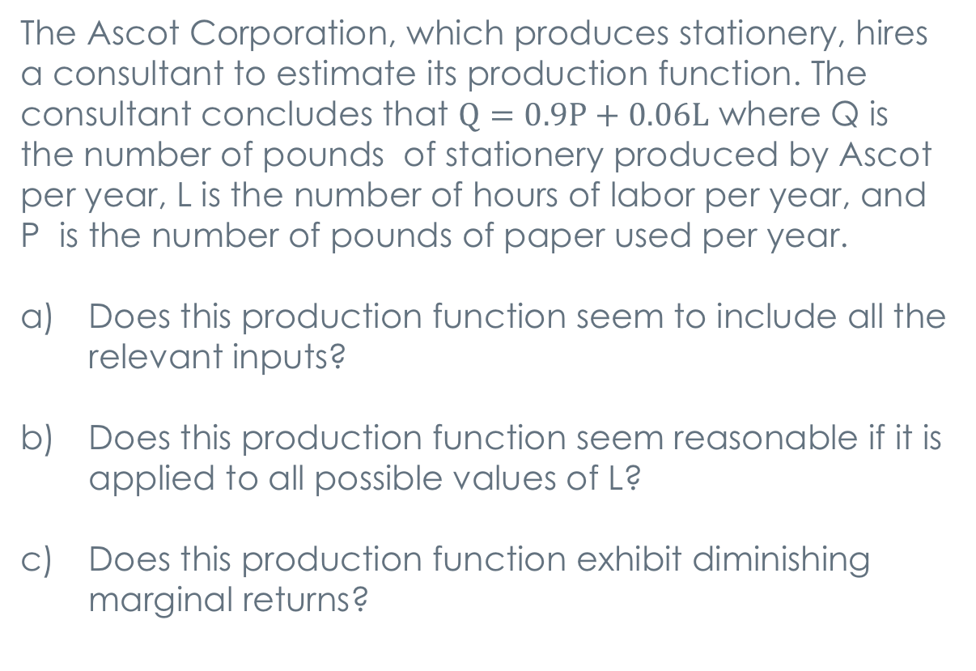
QUESTION 3
The Ascot Corporation, which produces stationery, hires a consultant to estimate its production function. The consultant concludes that $Q=0.9P+0.06L$ where Q is the number of pounds of stationery produced by Ascot per year, L is the number of hours of labor per year, and P is the number of pounds of paper used per year.
Does this production function seem to include all the relevant inputs?
Does this production function seem reasonable if it is applied to all possible values of L?
Does this production function exhibit diminishing marginal returns?

Slide 41
SOLUTION 3
No. Not all relevant inputs are included, such as technology or physical capital.
No, at L=0, quantity is greater than 0 (if P is greater than 0), meaning that stationary is being produced through paper inputs only.
There are no diminishing marginal returns because the marginal product of each input is constant (MP_{p}=0.9 and MP_{L}=0.06)

Slide 42
QUESTION 4
A Cobb-Douglas production function was estimated for six types of farms. There were five inputs in the production function: (1) land, (2) labour, (3) equipment, (4) livestock and feed, and (5) other resource services. The exponent of each input was as follows:
Farm Type | Land | Labour | Equipment | Livestock and Feed | Other Resource Services
Crop Farm | 0.24 | 0.07 | 0.08 | 0.53 | 0.02
Hog Farm | 0.07 | 0.02 | 0.10 | 0.74 | 0.03
Dairy Farm | 0.10 | 0.01 | 0.06 | 0.63 | 0.02
General Farms | 0.17 | 0.12 | 0.16 | 0.46 | 0.03
Large Farms | 0.28 | 0.01 | 0.11 | 0.53 | 0.03
Small Farms | 0.21 | 0.05 | 0.08 | 0.43 | 0.03

Slide 43
QUESTION 4
Do there appear to be increasing returns to scale in any of these six types of farms?
In what type of farm does a 1% increase in labour have the largest % effect on output?
Based on these results, would you expect output to increase if many of the farms included in this sample merged?

Slide 44
Solution 4a
Farm Type | Land | Labour | Equipment | Livestock and Feed | Other Resource Services | Exponent Total
Crop Farm | 0.24 | 0.07 | 0.08 | 0.53 | 0.02 | 0.94
Hog Farm | 0.07 | 0.02 | 0.10 | 0.74 | 0.03 | 0.96
Dairy Farm | 0.10 | 0.01 | 0.06 | 0.63 | 0.02 | 0.82
General Farms | 0.17 | 0.12 | 0.16 | 0.46 | 0.03 | 0.94
Large Farms | 0.28 | 0.01 | 0.11 | 0.53 | 0.03 | 0.96
Small Farms | 0.21 | 0.05 | 0.08 | 0.43 | 0.03 | 0.8
a) No. Summing the exponents of each farms’ production function, no farm’s exponents’ sum exceed a value of 1.

Slide 45
SOLUTION 4b,c
b) General Farms exhibits the highest exponent on its labour input, showing a 12% increase in output from a 1% increase in labour.
c) No. Each farm has decreasing returns to scale. Also, Large Farm does not operate at increasing returns to scale even though it is much larger than the other farms.

Slide 46
QUESTION 5
According to the chief engineer at the Zodiac Company, Q=AL^{α}K^{β}, where Q is the output rate, L is the rate of labor input, and K is the rate of capital input. Statistical analysis indicates that alpha =0.8 and beta =0.3. The firm’s owner claims the plant has increasing returns to scale.
Is the owner correct?
b) If β were 0.2 rather than 0.3, would she still be correct?
c) Does output per unit of labor depend only on α and β ? Why or why not?

Slide 47
SOLUTION 5
Yes, he is correct, since 0.8+0.3 > 1
b) If β were 0.2 rather than 0.3, the production function would exhibit constant returns to scale and therefore would be incorrect in asserting that he it exhibits increasing returns to scale
c) Output per unit of labour also depends on A and K. Average output for each unit of labor:
Q/L = AL^{a-1}K^{β}

Slide 48
QUESTION 6
According to data obtained by the U.S. Department of Agriculture, the relationship between cow’s total output of milk and the amount of grain it is fed is as follows:
Amount of Grain (Pounds) | Amount of Milk (Pounds)
1,200 | 5,917
1,800 | 7,250
2,400 | 8,379
3,000 | 9,371

Slide 49
QUESTION 6
Calculate the average product of grain when each amount is used.
Estimate the marginal product of grain when between all the quantities.

Slide 50
SOLUTION 6
Amount of Grain (Pounds) | Amount of Milk (Pounds) | AP | MP
1,200 | 5,917 | 5917/1200=4.93
1,800 | 7,250 | 7250/1800=4.03 |  | 2.22
2,400 | 8,379 | 8379/2400=3.49 |  | 1.88
3,000 | 9,371 | 9371/3000=3.12 |  | 1.65

Slide 51
SOLUTION 6
c) Does this production function exhibit diminishing marginal returns?
Yes, the marginal product decreases as the amount of grain (input) increases

Slide 52
QUESTION 7
An electronics plant’s production function is Q=5LK
The price of labor is $1 per unit of labor
The price of capital is $2 per unit of capital
What combination of inputs should the plant use to produce 20 units of output per period?
What advice would you give him?

Slide 53

SOLUTION 7
Want to know what combination of capital and labour produce an output of 20 units:
L=2K is the relationship between capital and labour, substitute into original production function:
$$20=5KL$$
$$20=5K\left(2K\right)$$
$$4={2K}^{2}$$
$$K=\sqrt{2}$$
$$L= 2\sqrt{2}$$

Slide 54
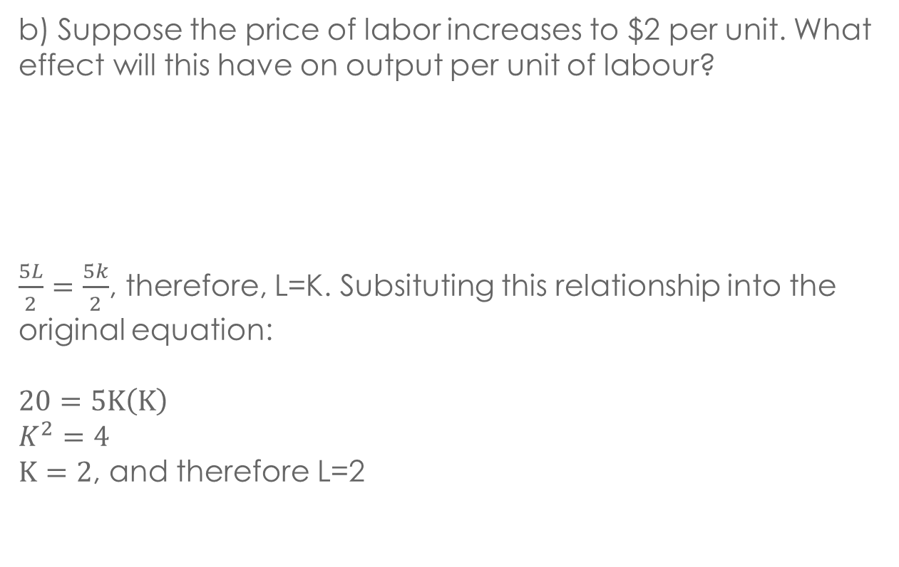
QUESTION 7
b) Suppose the price of labor increases to $2 per unit. What effect will this have on output per unit of labour?
$\frac{5L}{2}=\frac{5k}{2}$, therefore, L=K. Subsituting this relationship into the original equation:
$$20=5K\left(K\right)$$
$$K^{2}=4$$
$K=2$, and therefore L=2

Slide 55
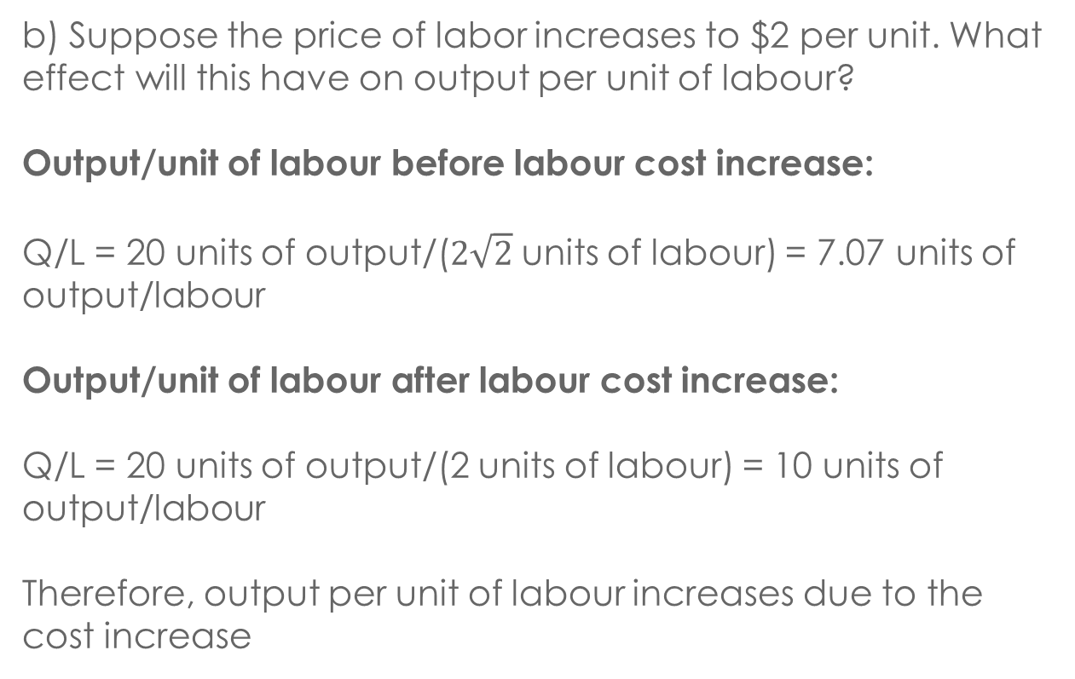
QUESTION 7
b) Suppose the price of labor increases to $2 per unit. What effect will this have on output per unit of labour?
Output/unit of labour before labour cost increase:
Q/L = 20 units of output/($2\sqrt{2}$ units of labour) = 7.07 units of output/labour
Output/unit of labour after labour cost increase:
Q/L = 20 units of output/(2 units of labour) = 10 units of output/labour
Therefore, output per unit of labour increases due to the cost increase

Slide 56
QUESTION 7
c) Is this plant subject to decreasing marginal returns to scale? Why or why not?
The sum of the exponents of L and K (1+1) is 2 which is greater than 1, therefore it has increasing returns to scale.

Slide 57
Q&A

